Slide 1
Building modern conversations in Office365 with add-ins and actionable messages
Shanmugam Senthil
Principal Group Engineering Manager
Pankaj Pal
Senior Software Engineer
Notes:
How many have you are Outlook users?
How have you used Outlook add-ins or Actionable Messages?
How many of you have developed an add-in

Slide 2
Agenda
Add-ins & Actionable messages
Demo - New capabilities
What is coming
Best practices

Slide 3
Outlook extensions
Conversations
Actionable messages
Add-ins
1
Microsoft Graph
Notes:
I will be talking about extensions in Outlook. However, the same concept applies to any office application.
Our focus in todays deep dive is on conversations canvas which is the centerpiece in Outlook (specifically Outlook) and how you can extend them to power personalized scenarios to Outlook users.
Add-ins are integrations that let developers extend Outlook UI & capabilities thereby enabling end users to bring their favorite apps right in email
These extensions are based on simple, open, web technologies
Office automatically adapts these extensions to the right experience, depending on the app and platform where they appear. For example, a command in Outlook desktop shows up as a button in the ribbon, while it shows up in a separate menu in Outlook mobile
You can also extend the canvases themselves with custom content
This custom content can be as simple as text or a static image, or it can scale up to fully custom HTML and JavaScript-powered content, depending on the needs of your scenario
Actionable messages Increase engagement with your app or service by surfacing contextual actions directly in conversations in Outlook so users can accomplish tasks faster
An example would be like a comment to your document directly from the mail canvas itself.
Graph Build smarter apps by connecting to the data that drives productivity
We will do a deep dive on all three via demo and look at the code samples

Slide 4
Join the Outlook Platform
Reach
Maturity
Availability
100M Office 365 Enterprise users/mo.
500M Outlook.com users
350+ Add-Ins
100+ Connectors
2.5M+ Actionable emails
Desktop
Windows
Mac
Web
Mobile
iOS
Android

Slide 5
Add-ins

Slide 6
OFFICE ADD-INS
Integrations built by third parties into Office products
COM/VSTO Web Add-ins
ADVANTAGES OF WEB ADD-INS
Does not install code physically onto a user’s device
One code all platforms
Centralized deployment and distribution
Submit on App Source, find your app on all platforms!
WHY YOU SHOULD USE OFFICE PLATFORM
Add new functionality to office clients
Create new rich interactive objects
Microsoft Graph API to connect to data that drives productivity
5M
799
MAU (Monthly Active Users)
1209
Apps available
Partners onboarded
Notes:
https://docs.microsoft.com/en-us/outlook/add-ins/
Power BI
https://msit.powerbi.com/groups/me/dashboards/bc267a21-8355-43e7-ba04-ac7b1b4425ed/reports/4989cef7-896d-4c42-9c3b-5f496a0114cf/ReportSection
Available in OWA, Win32, mac, ios and Android
Only mail read support in iOS and Android

Slide 7
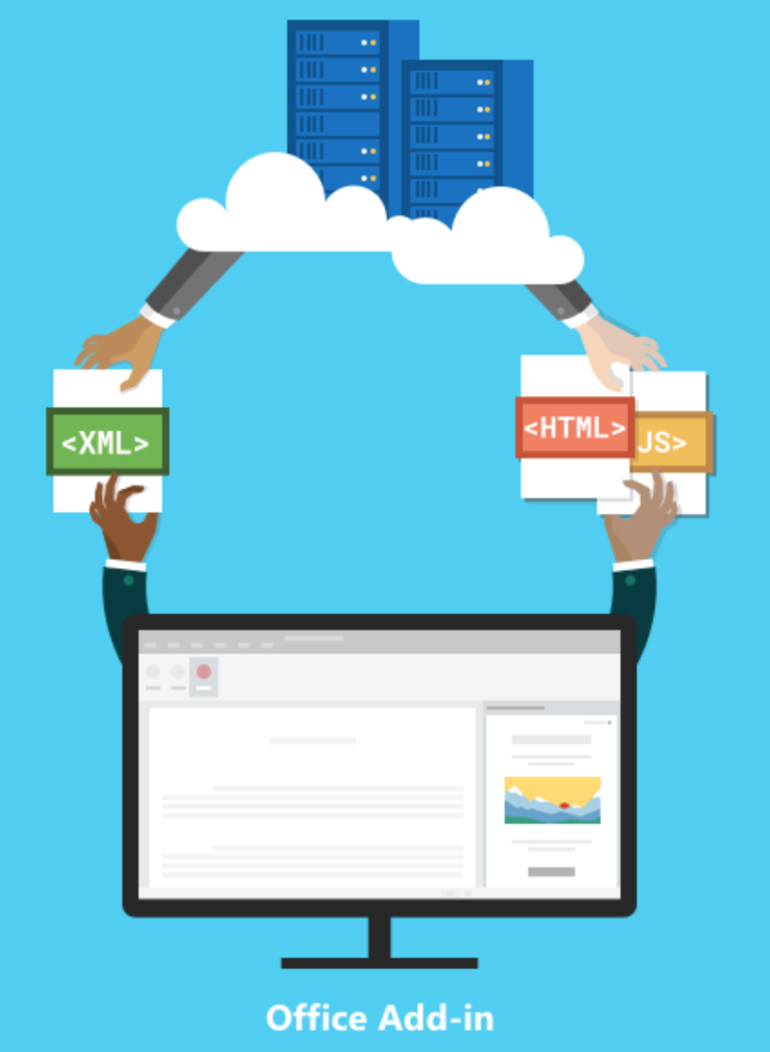
COMPONENTS OF ADD-IN
Manifest
Web App
Specifies settings and capabilities of the Add-in such as:
Permission levels
Data access levels
How it integrates with Outlook
HTML + JS files hosted on a server or hosting service
Specifies Add in UI and behavior
Uses Office JS API to interact with office clients
Notes:
https://docs.microsoft.com/en-us/office/dev/add-ins/overview/office-add-ins?context=outlook/context

Slide 8


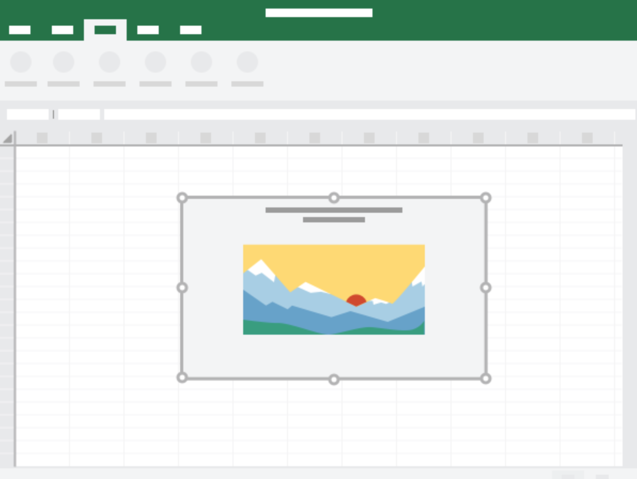
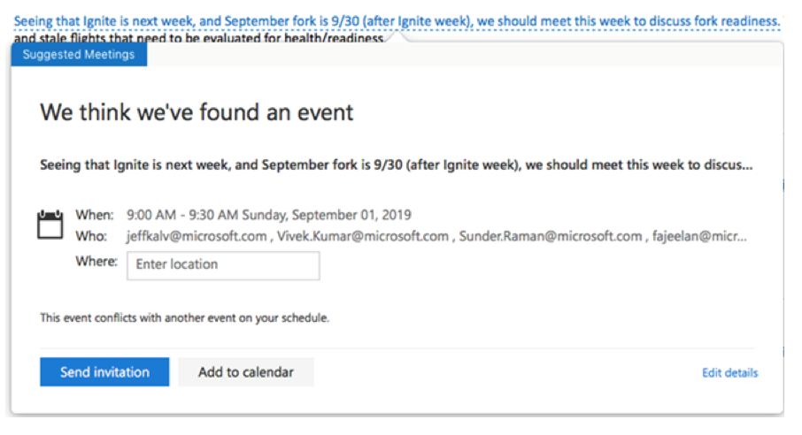
EXTENSION POINTS
Extend office functionality
Create new objects
1) Custom Buttons
Content Add-ins that integrate rich web-based data visualizations or media into Excel or Power Point
2) Task Pane
3) Contextual
Add-ins
Notes:
https://docs.microsoft.com/en-us/office/dev/add-ins/overview/office-add-ins?context=outlook/context

Slide 9
Demo – Create new Outlook addin
Install Node.js
Install latest version of Yeoman and the Yeoman generator for Office Add-ins using command “npm install -g yo generator-office”
Create folder “MyOutlookAddin” and navigate to that folder
Create Outlook addin project by running “yo office” and choosing following values
Choose a project type - Office Add-in project using Jquery framework
Choose a script type - Javascript
What do you want to name your add-in? - My Office Add-in
Which Office client application would you like to support? - Outlook
Navigate to “My Office Add-in” folder and update index.html, src/index.js, app.css and manifest xml file as required.
“npm start” to start service at https://localhost:3000. If npm start fails, pls update webpack-cli version: npm install --save-dev webpack-cli@3.1.2 and then try again.
Sidelaod addin in Outlook client and use it
Refer https://docs.microsoft.com/en-us/outlook/add-ins/quick-start?tabs=visual-studio-code
Notes:
Demo commands:
npm install -g yo generator-office
yo office
npm install --save-dev webpack-cli@3.1.2
npm start
Code Snippets:
//to be added index.html, line 39
//Adds html buttons in the page
<div class="buttonDiv" >
<input type="button" id="getsubject" class="ms-Button" value="Get Subject" >
</div>
<div class="buttonDiv" style= "margin-top: 20px">
<input type="button" id="getbody" class="ms-Button" value="Get Body" >
</div>
<div class="buttonDiv" style= "margin-top: 20px">
<input type="button" id="sentnotification" class="ms-Button" value="Send Notification">
</div>
<div id="outputstr"></div>
//to be added in index.html before closing body tag
//includes index.js file to bring in js functionalities written in the file
<script type="text/javascript" src="src/index.js"></script>
//to be added in src/index.js at the end of file
//function to get body content of email
function getBodyContent() {
try
{
Office.context.mailbox.item.body.getAsync(
Office.CoercionType.Text,
{ asyncContext:"This is passed to the callback" },
function callback(asyncResult) {
if (asyncResult.status == "failed") {
console.log("Action failed with error: " + asyncResult.error.message);
}
else {
$("#outputstr").text(asyncResult.value.trim());
}
});
} catch(err)
{
console.log(err.message);
}
}
//function to send notification to mail
function sendNotification() {
Office.context.mailbox.item.notificationMessages.replaceAsync(
"myTestAddin",
{
type: "informationalMessage",
icon: "icon1_16x16",
message: "Hello Pune!!",
persistent: false
},
function (asyncResult) {
if (asyncResult.status == "failed") {
console.log("Action failed with error: " + asyncResult.error.message);
} else {
console.log("Check the new notification.");
}
});
}
//below code to be added in src/index.js in line 10
//glue code to connect button click to function calls
$('#getsubject').click(function(){
$("#outputstr").text(Office.context.mailbox.item.subject);
});
$('#getbody').click(function(){
getBodyContent();
});
$('#sentnotification').click(function(){
sendNotification();
});
//CSS styling to wrap out text to be added in app.css file
#outputstr
{
width:350px;
word-wrap: break-word;
}

Slide 10
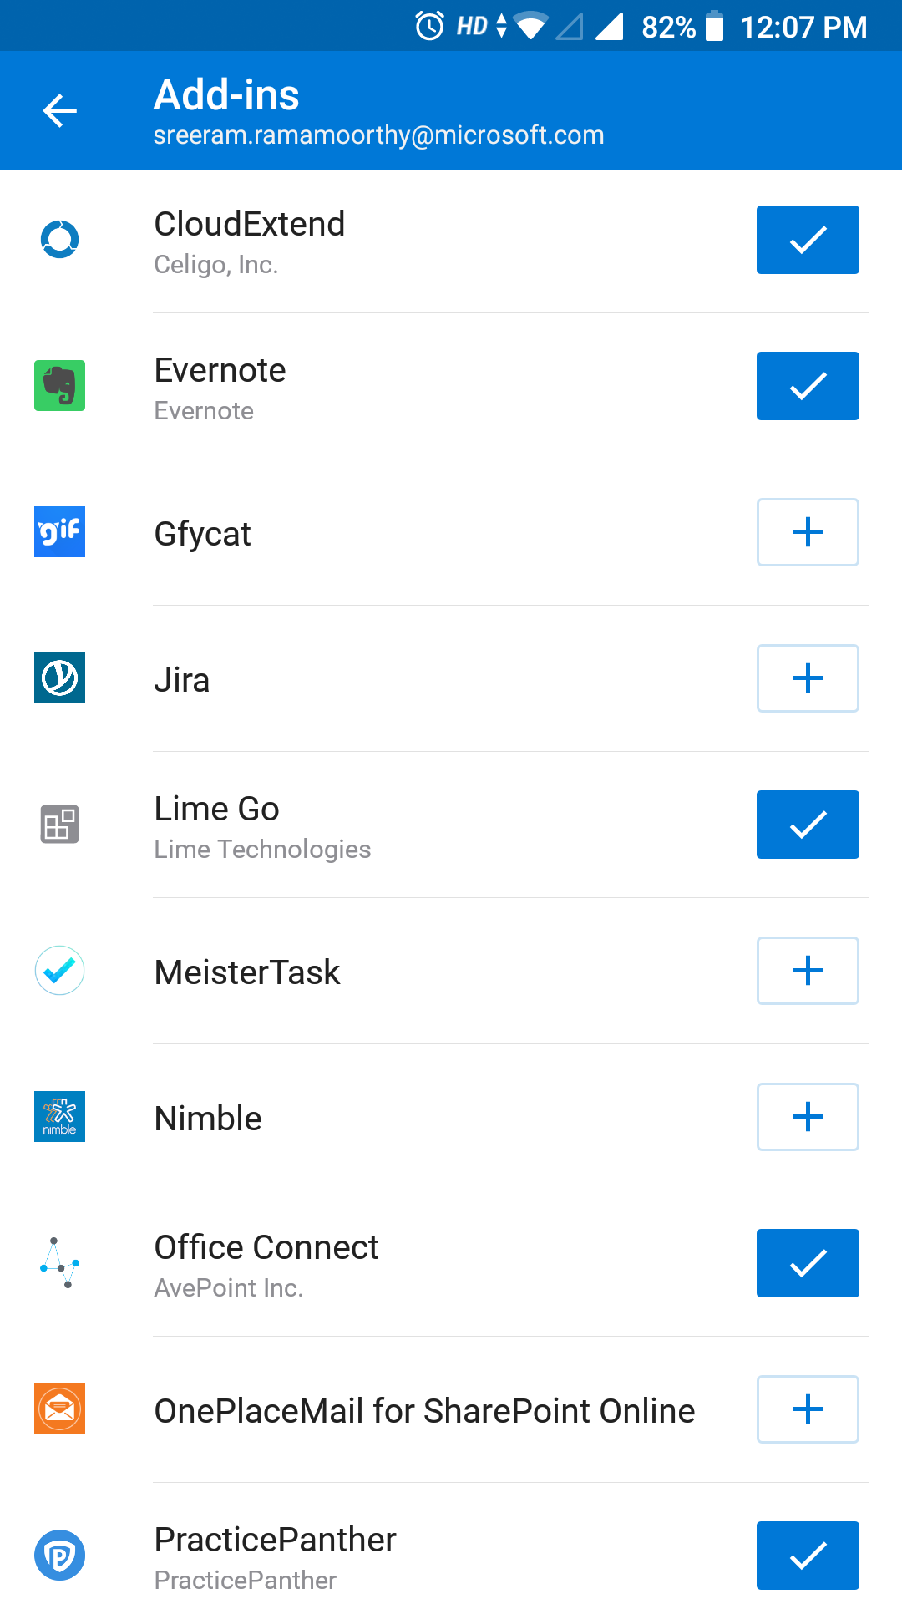
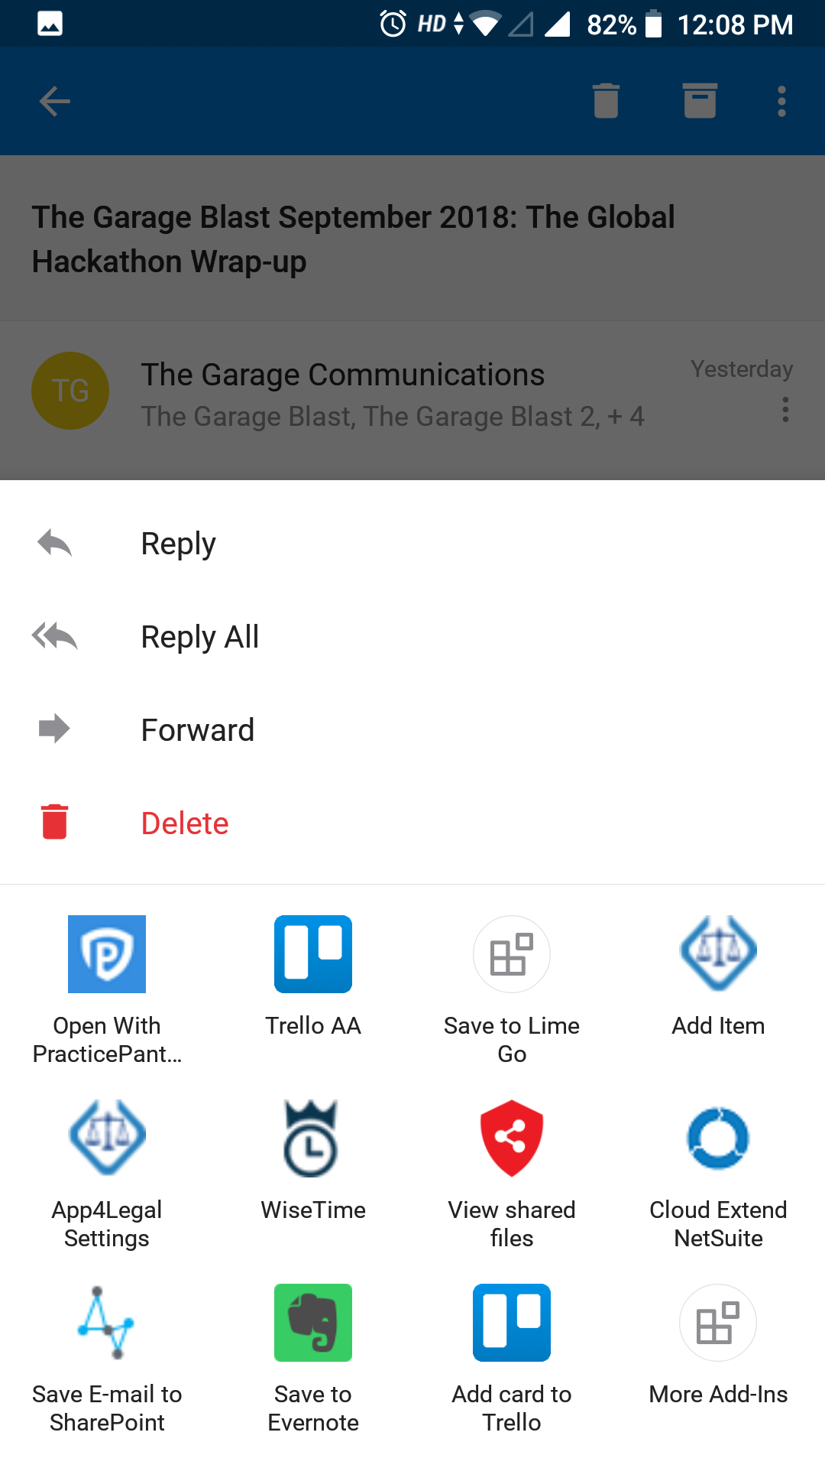
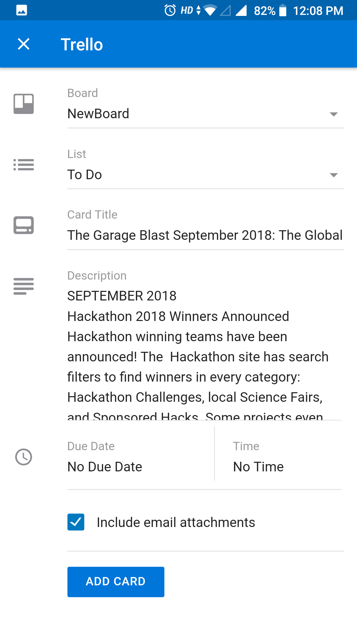
Now, also on Outlook Mobile

Slide 11
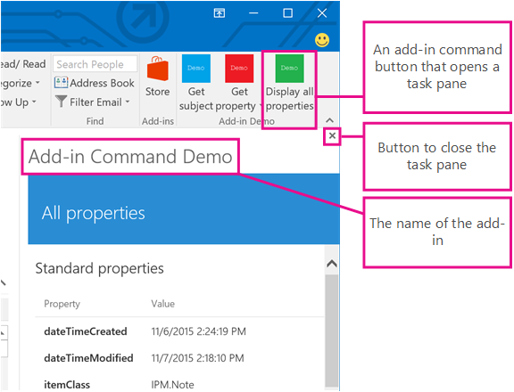

WHAT’S NEW?
New Releases
Persistent Task Pane
Centralized Deployment
Centralized deployment of
Add-ins Average of 1M
Add-ins deployed per
month
Deep Linking
Launch in-client store,
add-in details page from
emails
Notes:
Great deployment model for enterprise admin and itpros. Essentially it alow admin push addin to any office 365 group and as member join the group they will get the add-in automatically
Deep linking – say you have a marketing campaign for the add-in or send an email internally to your employees telling them about the add-in Just send an email with a link, clicking on the link will automatically install the add-in for the user
Continuous update to Outlook, Word and excel APIs – newer version coming out always check out dev.office.com
New API to display native dialog. You might want to open a dialog box from a task pane or content add-in or add-in command to:
1. Display sign-in pages that cannot be opened directly in a task pane. Or need to sign-in user before executing the background task
2. Provide more screen space, or even a full screen, for some tasks in your add-in.
3. Host a video that would be too small if confined to a task pane.
Persistent ask pane
https://docs.microsoft.com/en-us/office/dev/add-ins/design/task-pane-add-ins

Slide 12
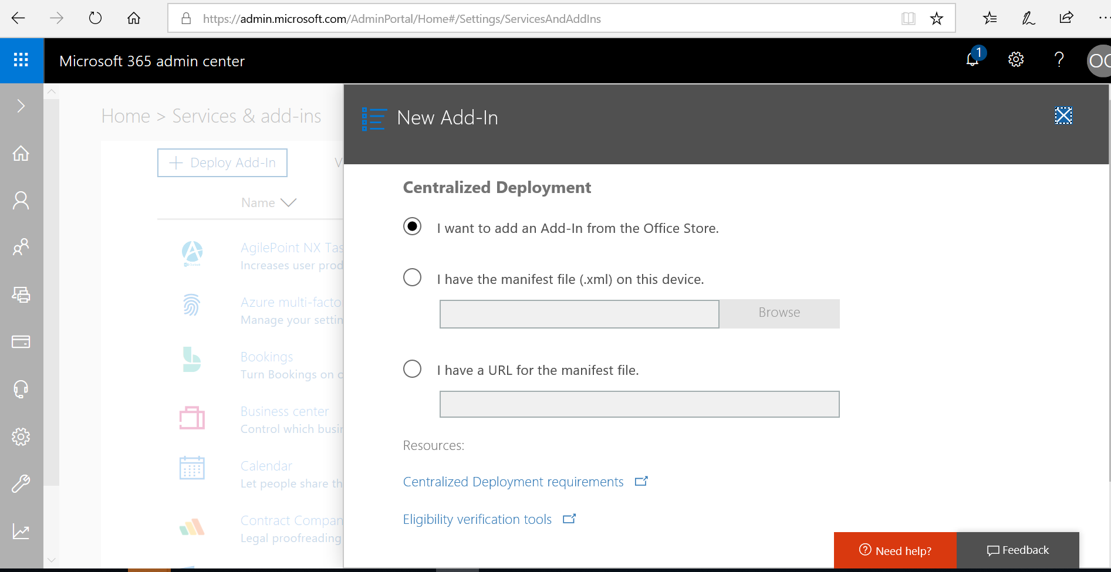
Add-in Distribution
Share manifest file with users and ask them side load
Automatically install add-in for specific users/groups using centralized deployment feature @ https://admin.microsoft.com/AdminPortal/Home#/Settings/ServicesAndAddIns

Slide 13
Actionable messages

Slide 14
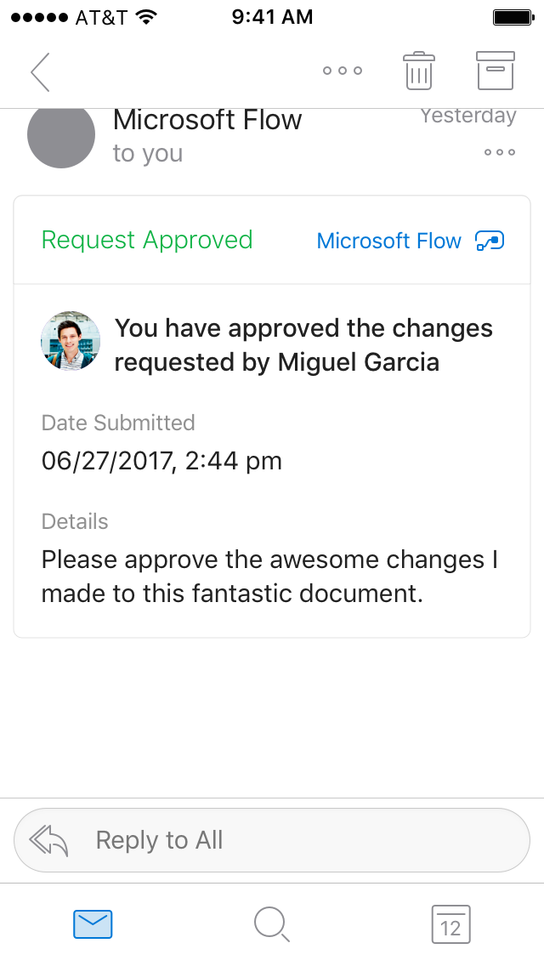
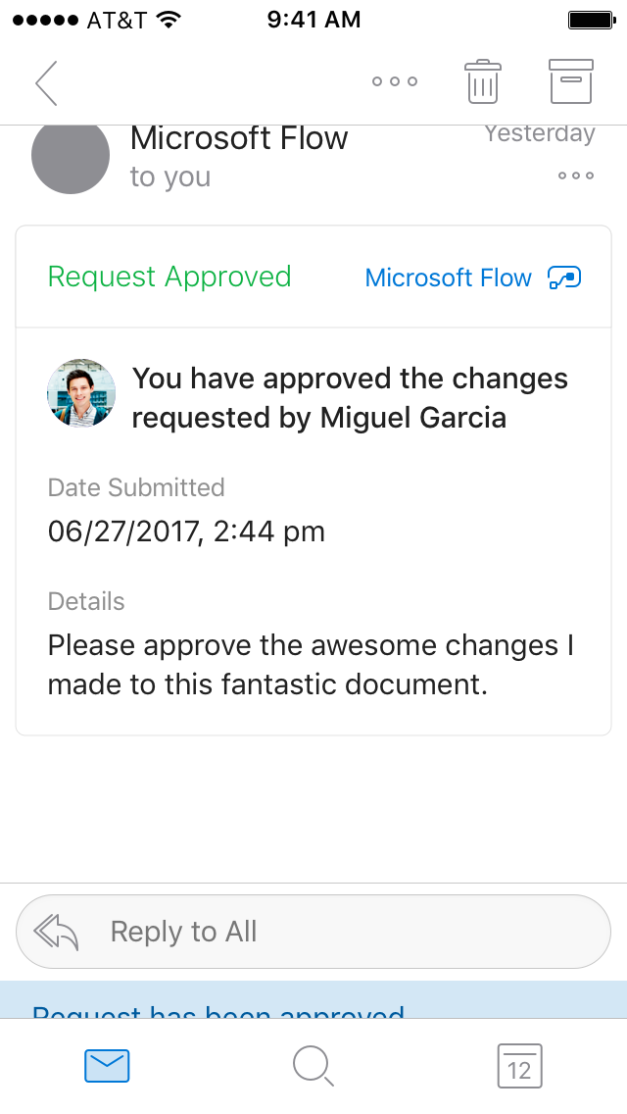
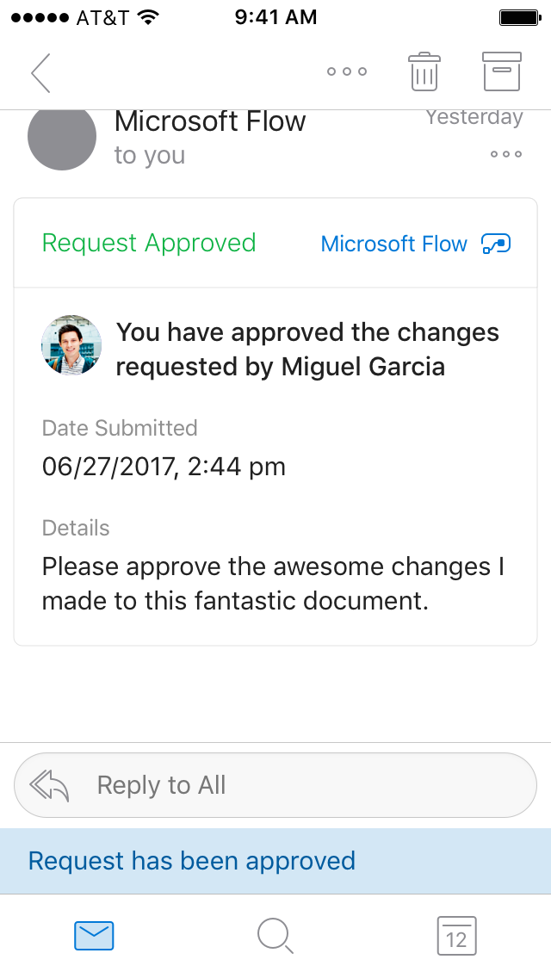
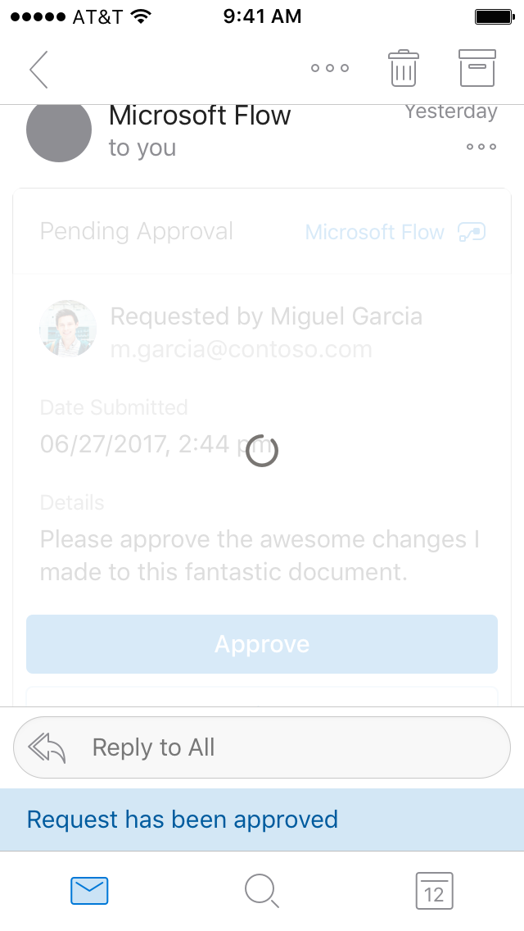
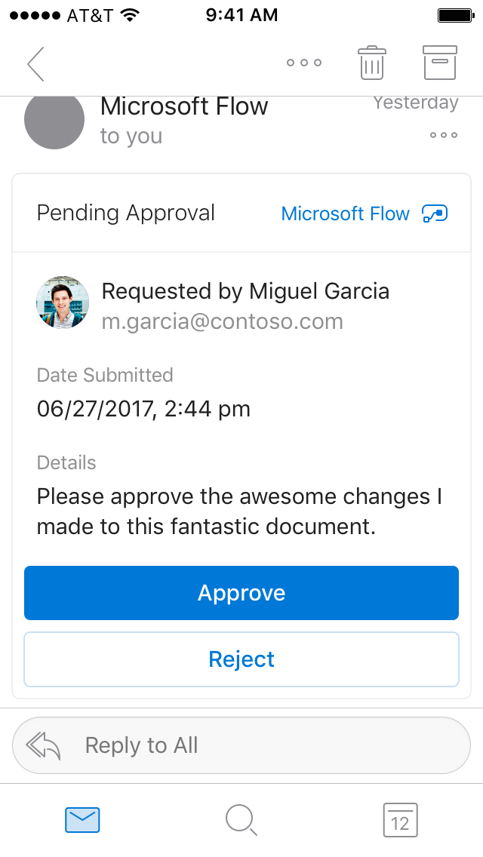

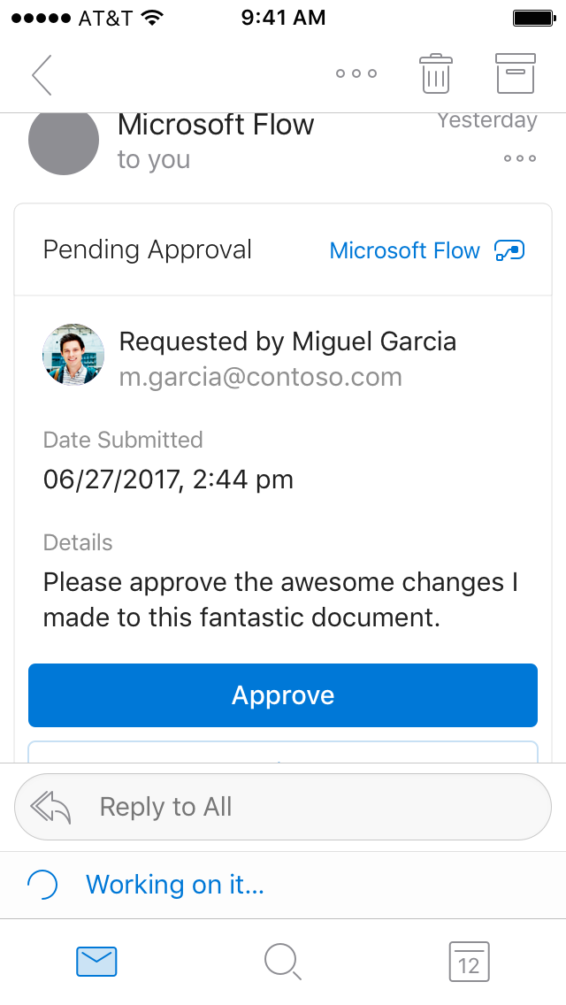
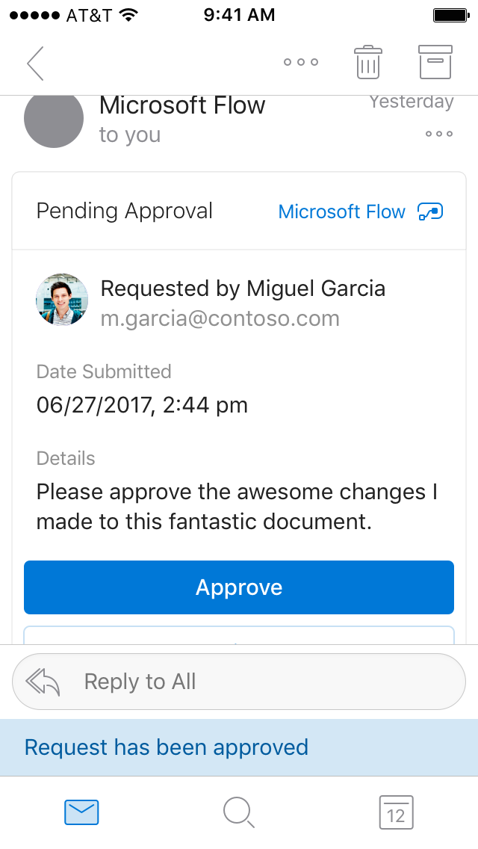
Actionable Messages enable you to take quick actions right from within an email
Users can take actions within an email and get a response instantly right there.
With this platform developers can now embed actions in their emails increasing user engagement with their services, as well as enhancing the user’s productivity.
Notes:
Enables you to take quick actions right from within the email without ever leaving outlook
This is contrast to the existing experience of click -> open browser -> load page ->signin -> load action page -> action

Slide 15
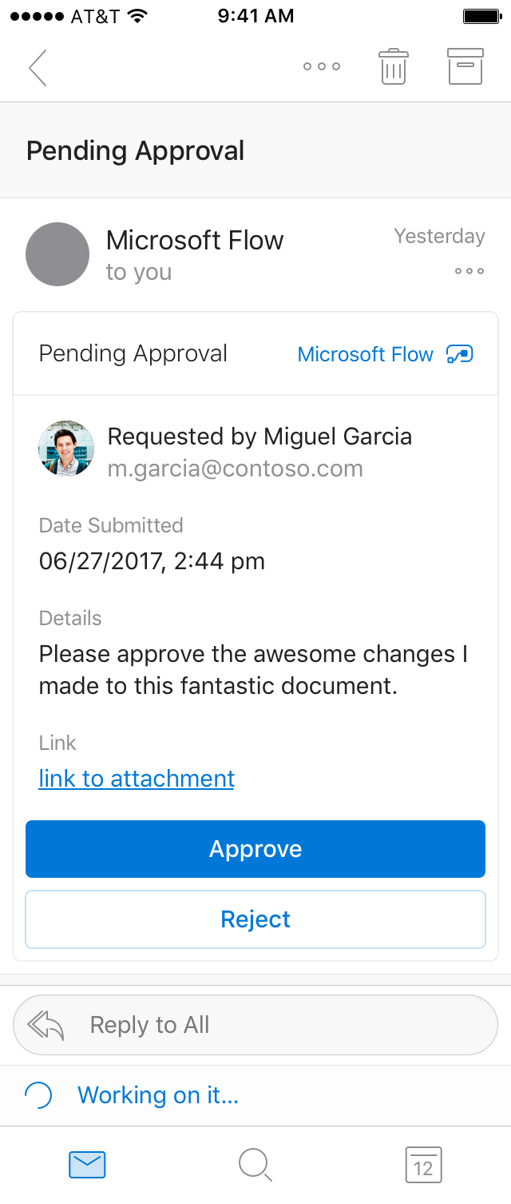

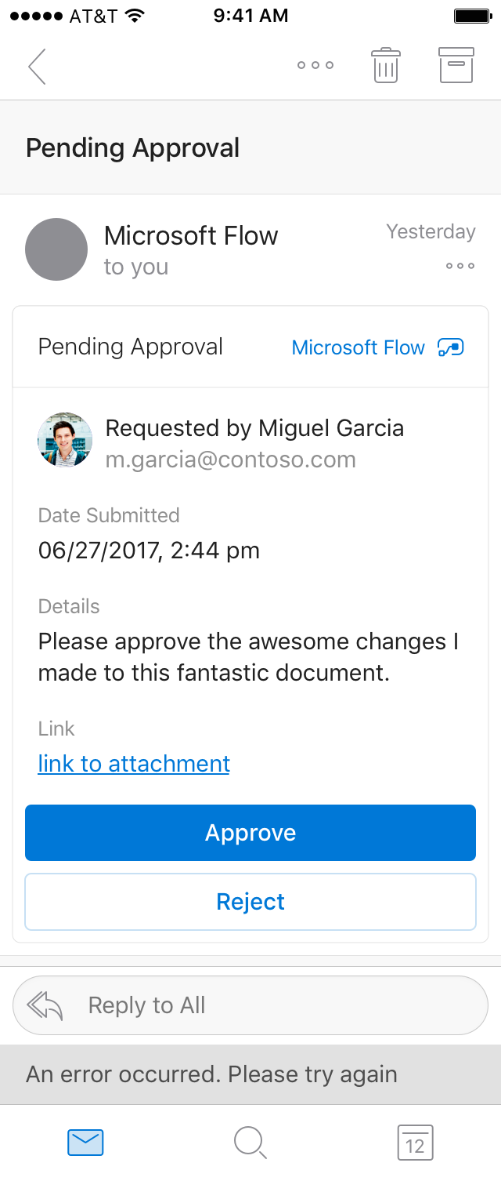
iOS
Native to every Outlook Endpoint
Design an actionable message card once, and it will render seamlessly as per the respective Outlook endpoint’s design patterns.
Notes:
And these messages render native to the platform where they are viewed.
And this benefit comes with little or no extra cost to the developer.
Define the UI in a declarative language called Adaptive cards and we take care of making the UI compatible to that end point

Slide 16
Scenario Archetypes
Here are a few scenarios that actionable messages can be used for.
Please note that this is an illustrative list of scenarios, and is WIP.
Expense/Invoice Expense Approvals, Invoice Payments, Review Details, Reject with comments
Zoho
MS Approvals
Workflows Vacation approvals, Membership requests, Access approvals, Assign, Re-assign
Kronos
Polls/Surveys Vote, Leave feedback, Rate, Comment, Choose from a list, View dynamic poll results
Survey Monkey
ServiceNow

Slide 17
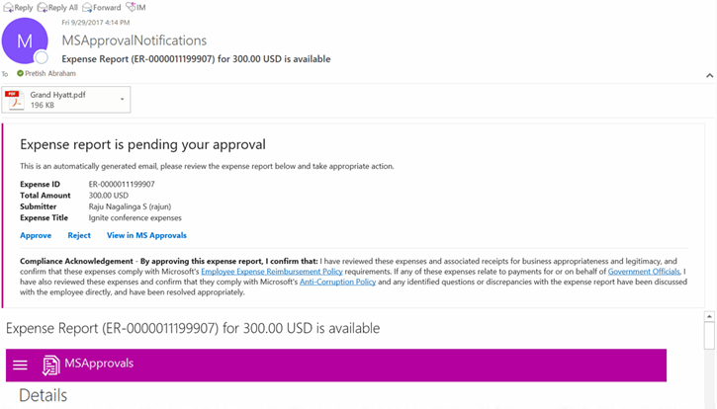

Actionable Messages – Early impact
Magical experience “I just got an expense actionable message and it was MAGICAL. Good stuff”
Time to act reduction
Time to approve reduced from 6 days to within 17 hours (at 85th %le).
Scales to other approval flows (ROI) Expanding to four more MS products, covering POs, vendor invoicing and vacation approvals
MS Approvals
Notes:
3 success stories to talk about
MS approvals usecases., where after moving to AM, they saw the time to approve dropped from 6 days to 17 hours leading to $1.5mn savings in late payment fees
Sharepoint saw that engagement with their emails went from 30% to 70% and the time to act dropped from 2 days to 30 min
We have over 2700 large tenants using AM to power their LOB workflows.

Slide 18
Demo
Actionable Message
Notes:
Actionable messages overview : https://docs.microsoft.com/en-us/outlook/actionable-messages/
Playground for AM: https://messagecardplayground.azurewebsites.net/
Adaptive card documentation: http://adaptivecards.io/
AM registration portal: https://acdesignerstaging.azurewebsites.net/
Github link for adaptive card library : https://github.com/Microsoft/AdaptiveCards
Adaptive card Drag-n-Drop designer(preview) - https://acdesignerstaging.azurewebsites.net/
Copy the following json to message card playground and add some text in the input box : https://messagecardplayground.azurewebsites.net/
{
"$schema": "http://adaptivecards.io/schemas/adaptive-card.json",
"type": "AdaptiveCard",
"version": "1.0",
"body": [
{
"type": "TextBlock",
"text": "**Sample Card to test actions using Azure functions**"
},
{
"type": "Input.Text",
"isMultiline": true,
"id": "comment",
"placeholder": "Sample text"
}
],
"actions": [
{
"type": "Action.Http",
"isPrimary": true,
"method": "POST",
"title": "Add Comment",
"url": " https://papal-adaptivetesting.azurewebsites.net/api/authurl?code=Xkhy3R025U1eaxa4qn4B3GklZVGPHVvbuFO0OAkPR8NumOd/X1LCyw==",
"body": "{{comment.value}}"
}
]
}

Slide 19
Why you should care
IT Pros
Streamline workflows to minimize context switches, save time and increase productivity
Make the automated emails you already send actionable
ISVs
100 million+ Office 365 monthly active users
Integrate your solution in the Office apps your users already use on a daily basis (Outlook, Microsoft Teams)
Developers
Declarative by nature, Actionable Messages are easy to get started with
Leverage your existing services

Slide 20
Key Takeaways

Slide 21
Call To Action
Visit https://docs.microsoft.com/en-us/outlook/ to get started
Addins: https://docs.microsoft.com/en-us/outlook/add-ins/
Actionable Messages: https://docs.microsoft.com/en-us/outlook/actionable-messages/get-started
Adaptive Cards: http://adaptivecards.io/
Playground: https://messagecardplayground.azurewebsites.net/#
Questions on stackoverflow?
Add-ins: #outlook-web-addins
Actionable Messages: #office365connectors
Help us shape our roadmap
User Voice: https://aka.ms/officedevuservoice
Notes:
Emphasize that “We are listening” and encourage folks to go to user voice.

Slide 22
Why we love the modern platform…
Native experiences through web technologies
Write once run everywhere
Modern distribution and deployment
Templates and SDKs to get started quickly
Notes:
Tap into the Office and Outlook audience
Easy to build and deploy

Slide 23
Looking forward
New APIs
Parity of features across Outlook Clients
More extension points
Performance improvements
Centralized deployment: Usage report dashboard
Notes:
Usage report: looking at building a usage report where admins can see how many people have the add-in and how many people are using it across different Outlook Clients.
Pinnable taskpane in other Outlook clients
SSO in other Outlook clients
GRAPH APIs that are in progress:
Search Folders
Email as EML/MIME
Email backup APIs
New calendar sharing models and access to delegate’s calendar via it
Developer dashboard
Periodic updates for developers to get key metrices.

Slide 24
Thank You
Notes:
Actionable messages overview : https://docs.microsoft.com/en-us/outlook/actionable-messages/
Playground for AM: https://messagecardplayground.azurewebsites.net/
Adaptive card documentation: http://adaptivecards.io/
AM registration portal: https://acdesignerstaging.azurewebsites.net/
Github link for adaptive card library : https://github.com/Microsoft/AdaptiveCards
Adaptive card Drag-n-Drop designer(preview) - https://acdesignerstaging.azurewebsites.net/
Copy the following json to message card playground and add some text in the input box : https://messagecardplayground.azurewebsites.net/
{
"$schema": "http://adaptivecards.io/schemas/adaptive-card.json",
"type": "AdaptiveCard",
"version": "1.0",
"body": [
{
"type": "TextBlock",
"text": "**Sample Card to test actions using Azure functions**"
},
{
"type": "Input.Text",
"isMultiline": true,
"id": "comment",
"placeholder": "Sample text"
}
],
"actions": [
{
"type": "Action.Http",
"isPrimary": true,
"method": "POST",
"title": "Add Comment",
"url": " https://papal-adaptivetesting.azurewebsites.net/api/authurl?code=Xkhy3R025U1eaxa4qn4B3GklZVGPHVvbuFO0OAkPR8NumOd/X1LCyw==",
"body": "{{comment.value}}"
}
]
}

